Slide 1
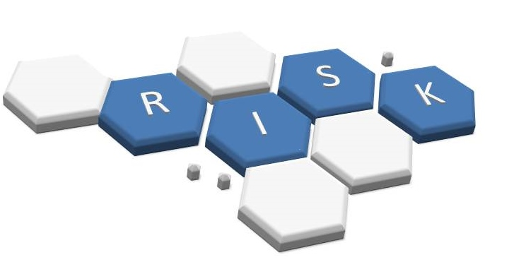
Security Risk Assessment

Slide 2
Outline
Security Risk Assessment
What is Risk?
How does security risk assessment work?
Common Challenges
Security Risk Assessment Model
IT Risk Assessment Procedure

Slide 3
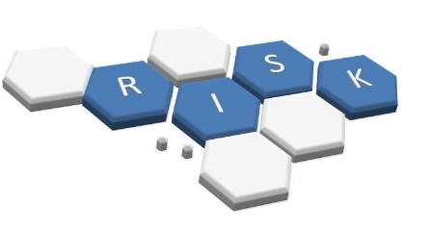
Security risk assessment
Cybersecurity is all about understanding, managing, controlling and mitigating risk to your organization’s critical assets.
To get started with IT security risk assessment, you need to answer three important questions:
  What are your organization’s critical information technology assets — that is, the data whose exposure would have a major impact on your business operations?
  What are the top five business processes that utilize or require this information?
  What threats could affect the ability of those business functions to operate?

Slide 4
Security risk assessment
Once you know what you need to protect, you can begin developing strategies.
However, before you spend a dollar of your budget or an hour of your time implementing a solution to reduce risk, you should be able to answer the following questions:
  What is the risk you are reducing?
  Is it the highest priority security risk?
  Are you reducing it in the most cost-effective way?
These questions get to the heart of the problem — that it is all about risk.

Slide 5

What is Risk?
Risk is a business concept — is the likelihood of financial loss for the organization high, medium, low or zero?
Three factors play into risk determination:
  what the threat is,
  how vulnerable the system is,
  the importance of the asset that could be damaged or made unavailable.
Thus, risk can be defined as follows:
Risk = Threat x Vulnerability x Asset

Slide 6
What is Risk?
Although risk is represented here as a mathematical formula, it is not about numbers; it is a logical construct.
For example, suppose you want to assess the risk associated with the threat of hackers compromising a particular system.
  If your network is very vulnerable (perhaps because you have no firewall and no antivirus solution), and the asset is critical, your risk is high.
  However, if you have good perimeter defenses and your vulnerability is low, and even though the asset is still critical, your risk will be medium.

Slide 7
What is Risk?
There are two special cases to keep in mind:
  Anything times zero is zero. If any of the factors is zero, even if the other factors are high or critical, your risk is zero.
  Risk implies uncertainty. If something is guaranteed to happen, it is not a risk.
Here are some common ways you can suffer financial damage:
  Data loss. Theft of trade secrets could cause you to lose business to your competitors. Theft of customer information could result in loss of trust and customer attrition.
  System or application downtime. If a system fails to perform its primary function, customers may be unable to place orders, employees may be unable to do their jobs or communicate, and so on.
  Legal consequences. If somebody steals data from one of your databases, even if that data is not particularly valuable, you can incur fines and other legal costs because you failed to comply with the data protection security requirements of HIPAA (Health Insurance Portability and Accountability Act)or other compliance

Slide 8
What is a security risk assessment?
A security risk assessment identifies, assesses, and implements key security controls in applications.
It also focuses on preventing application security defects and vulnerabilities.
Carrying out a risk assessment allows an organization to view the application portfolio holistically—from an attacker’s perspective.
It supports managers in making informed resource allocation, tooling, and security control implementation decisions.
Thus, conducting an assessment is an integral part of an organization’s risk management process.

Slide 9
How does a security risk assessment work?
Factors such as size, growth rate, resources, and asset portfolio affect the depth of risk assessment models.
Organizations can carry out generalized assessments when experiencing budget or time constraints.
However, generalized assessments don’t necessarily provide the detailed mappings between assets, associated threats, identified risks, impact, and mitigating controls.
If generalized assessment results don’t provide enough of a correlation between these areas, a more in-depth assessment is necessary.

Slide 10
Common Challenges
Failure to perform assessments effectively can lead to missed opportunities. Common business challenges include the following:
Cost, especially unbudgeted costs. Regardless, business and even IT units do not want to spend money on security controls unless they are absolutely necessary and usually tied to regulatory compliance or an audit citation. The business unit will minimize the privacy or security risk to avoid spending the money.
Unplanned activity, Any unplanned activity, whether it is part of a project or part of a yearly operating plan, will generate, at minimum, tension or push back. Project teams and management in general are inherently averse to doing any tasks they did not plan for.
Miscommunication: Many times, security managers communicate in terms of missing control risks or a policy non-compliance risk, not in terms of the operations or educational risk. As a result, it’s hard to achieve agreement to mitigate the risk(s), regardless of what control should be implemented.
User or customer impact: Any security control that changes the user experience will create resistance. Even if it’s minor such as increasing the length of passwords, it creates anxieties for business managers. Therefore, they will likely overstate implementation costs and try to delay implementation.
Incorrect estimating the costs of security controls. Sometimes the business or IT unit is uncertain about the implementation cost, and will incorrectly estimate the cost of the security controls.
Improperly relying on mitigating controls that do not effectively address the risk. A good example might be to rely on a manual review of system event logs instead of implementing an event monitoring system.

Slide 11
The 4 steps of a successful security risk assessment model
Identification. Determine all critical assets of the technology infrastructure. Next, diagnose sensitive data that is created, stored, or transmitted by these assets. Create a risk profile for each.
Assessment. Administer an approach to assess the identified security risks for critical assets. After careful evaluation and assessment, determine how to effectively and efficiently allocate time and resources towards risk mitigation. The assessment approach or methodology must analyze the correlation between assets, threats, vulnerabilities, and mitigating controls.
Mitigation. Define a mitigation approach and enforce security controls for each risk.
Prevention. Implement tools and processes to minimize threats and vulnerabilities from occurring in your firm’s resources.

Slide 12
What problems does a security risk assessment solve?
A comprehensive security assessment allows an organization to:
Identify assets (e.g., network, servers, applications, data centers, tools, etc.) within the organization.
Create risk profiles for each asset.
Understand what data is stored, transmitted, and generated by these assets.
Assess asset criticality regarding business operations. This includes the overall impact to revenue, reputation, and the likelihood of a firm’s exploitation.
Measure the risk ranking for assets and prioritize them for assessment.
Apply mitigating controls for each asset based on assessment results.

Slide 13
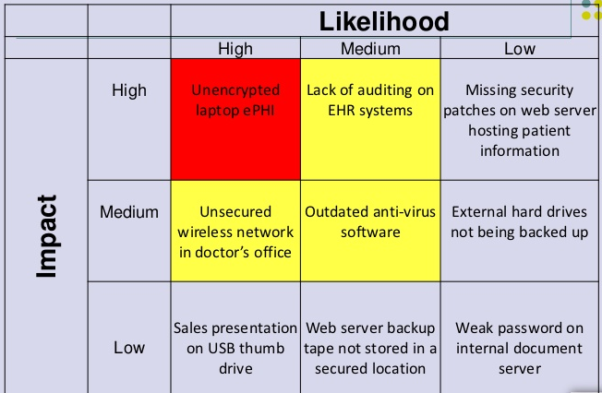
Sample Risk Assessment Template

Slide 14
What problems does a security risk assessment solve?
It’s important to understand that a security risk assessment isn’t a one-time security project. Rather, it’s a continuous activity that should be conducted at least once every other year.
Continuous assessment provides an organization with a current and up-to-date snapshot of threats and risks to which it is exposed.

Slide 15
What problems does a security risk assessment solve?
The assessment process creates and collects a variety of valuable information. A few examples include:
Creating an application portfolio for all current applications, tools, and utilities.
Documenting security requirements, policies, and procedures.
Establishing a collection of system architectures, network diagrams, data stored or transmitted by systems, and interactions with external services or vendors.
Developing an asset inventory of physical assets (e.g., hardware, network, and communication components and peripherals).
Maintaining information on operating systems (e.g., PC and server operating systems).
  Information about:
    Data repositories (e.g., database management systems, files, etc.).
    Current security controls (e.g., authentication systems, access control systems, antivirus, spam controls, network monitoring, firewalls, intrusion detection, and prevention systems).
    Current baseline operations and security requirements pertaining to compliance of governing bodies.
    Assets, threats, and vulnerabilities (including their impacts and likelihood).
    Previous technical and procedural reviews of applications, policies, network systems, etc.
    Mapping of mitigating controls for each risk identified for an asset.

Slide 16
IT risk assessment procedure
Step #1: Identify and Prioritize Assets
Assets include:
  Servers
  Website
  Client contact information
  Sensitive partner documents
  Trade secrets
  Customer credit card data
Remember, what you as a technician think is valuable might not be what is actually most valuable for the business. You need to work with business users and management to create a list of all valuable assets.

Slide 17
IT risk assessment procedure
For each asset, gather the following information, as applicable:
Software
Hardware
Data
Interfaces
Users
Functional requirements
Network topology
IT Security policies
IT Security architecture
Information storage protection
Information flow
Technical security controls

Slide 18
IT risk assessment procedure
Because most organizations have a limited budget for risk assessment, you will likely have to limit the scope of the project to mission-critical assets.
Accordingly, you need to define a standard for determining the importance of each asset.
Common criteria include the asset’s monetary value, legal standing and importance to the organization.
Once the standard has been approved by management and formally incorporated into the risk assessment security policy, use it to classify each asset you identified as critical, major or minor.

Slide 19
IT risk assessment procedure
Step #2: Identify Threats
A threat is anything that could exploit a vulnerability to breach security and cause harm to your organization. While hackers and malware probably leap to mind, there are many other types of threats:
Natural disasters. Floods, hurricanes, earthquakes, fire and other natural disasters can destroy much more than a hacker. You can lose not only data, but the servers and appliances as well. When deciding where to house your servers, think about the chances of a natural disaster. For instance, don’t put your server room on the first floor if your area has a high risk of floods.
System failure. The likelihood of system failure depends on the quality of your computer For relatively new, high-quality equipment, the chance of system failure is low. But if the equipment is old or from a “no-name” vendor, the chance of failure is much higher. Therefore, it’s wise to buy high-quality equipment, or at least equipment with good support.
Accidental human interference. This threat is always high, no matter what business you are in. Anyone can make mistakes such as accidentally deleting important files, clicking on malware links, or accidentally physical damaging a piece of equipment. Therefore, you should regularly back up your data, including system settings, ACLs and other configuration information, and carefully track all changes to critical systems.
Malicious humans. There are three types of malicious behavior:
  Interference is when somebody causes damage to your business by deleting data, engineering a distributed denial of service (DDOS) against your website, physically stealing a computer or server, and so on.
  Interception is classic hacking, where they steal your data.
  Impersonation is misuse of someone else’s credentials, which are often acquired through social engineering attacks or brute-force attacks, or purchased on the dark web.

Slide 20
IT risk assessment procedure
Step #3: Identify Vulnerabilities
A vulnerability is a weakness that a threat can exploit to breach security and harm your organization.
Vulnerabilities can be identified through vulnerability analysis, audit reports, the NIST (National Institute of standards and Technology-U.S. Department of Commerce) vulnerability database, vendor data, and system software security analysis.
Testing the IT system is also an important tool in identifying vulnerabilities. Testing can include the following:
  Information Security test and evaluation (ST&E) procedures
  Penetration testing techniques
  Automated vulnerability scanning tools
You can reduce your software-based vulnerabilities with proper patch management. But don’t forget about physical vulnerabilities. For example, moving your server room to the second floor of the building will greatly reduce your vulnerability to flooding.

Slide 21
IT risk assessment procedure
Step #4: Analyze Controls
Analyze the controls that are either in place or in the planning stage to minimize or eliminate the probability that a threat will exploit vulnerability in the system.
Controls can be implemented through:
  Technical means: such as computer hardware or software, encryption, intrusion detection mechanisms, and identification and authentication subsystems.
  Nontechnical controls include security policies, administrative actions, and physical and environmental mechanisms.
Both technical and nontechnical controls can further be classified as preventive or detective controls.
  As the name implies, preventive controls attempt to anticipate and stop attacks. Examples of preventive technical controls are encryption and authentication devices.
  Detective controls are used to discover attacks or events through such means as audit trails and intrusion detection systems.

Slide 22
IT risk assessment procedure
Step #5: Determine the Likelihood of an Incident
Assess the probability that a vulnerability might actually be exploited, taking into account the type of vulnerability, the capability and motivation of the threat source, and the existence and effectiveness of your controls.
Rather than a numerical score, many organizations use the categories high, medium and low to assess the likelihood of an attack or other adverse event.

Slide 23
IT risk assessment procedure
Step #6: Assess the Impact a Threat Could Have
Impact analysis should include the following factors:
  The mission of the system, including the processes implemented by the system
  The criticality of the system, determined by its value and the value of the data to the organization
  The sensitivity of the system and its data
The information required to conduct an impact analysis can be obtained from existing organizational documentation, including a business impact analysis (BIA) (or mission impact analysis report, as it is sometimes called).
This document uses either quantitative or qualitative means to determine the impact that would be caused by compromise or harm to the organization’s information assets.

Slide 24
IT risk assessment procedure
An attack or adverse event can result in compromise or loss of information system confidentiality, integrity and availability. As with the likelihood determination, the impact on the system can be qualitatively assessed as high, medium or low.
The following additional items should be included in the impact analysis:
  The estimated frequency of the threat’s exploitation of a vulnerability on an annual basis
  The approximate cost of each of these occurrences
  A weight factor based on the relative impact of a specific threat exploiting a specific vulnerability

Slide 25
IT risk assessment procedure
Step #7: Prioritize the Information Security Risks
For each threat/vulnerability pair, determine the level of risk to the IT system, based on the following:
  The likelihood that the threat will exploit the vulnerability
  The impact of the threat successfully exploiting the vulnerability
  The adequacy of the existing or planned information system security controls for eliminating or reducing the risk
A useful tool for estimating risk in this manner is the risk-level matrix.
  A high likelihood that the threat will occur is given a value of 1.0;
  a medium likelihood is assigned a value of 0.5;
  a low likelihood of occurrence is given a rating of 0.1.
Similarly, a high impact level is assigned a value of 100, a medium impact level 50, and a low impact level 10.
Risk is calculated by multiplying the threat likelihood value by the impact value, and the risks are categorized as high, medium or low based on the result.

Slide 26
IT risk assessment procedure
Step #8: Recommend Controls
Using the risk level as a basis, determine the actions that senior management and other responsible individuals must take to mitigate the risk. Here are some general guidelines for each level of risk:
  High— A plan for corrective measures should be developed as soon as possible.
  Medium — A plan for corrective measures should be developed within a reasonable period of time.
  Low — The team must decide whether to accept the risk or implement corrective actions.
As you consider controls to mitigate each risk, be sure to consider:
  Organizational policies
  Cost-benefit analysis
  Operational impact
  Feasibility
  Applicable regulations
  The overall effectiveness of the recommended controls
  Safety and reliability

Slide 27
IT risk assessment procedure
Step #9: Document the Results
The final step in the risk assessment process is to develop a risk assessment report to support management in making appropriate decisions on budget, policies, procedures and so on.
For each threat, the report should describe the corresponding vulnerabilities, the assets at risk, the impact to your IT infrastructure, the likelihood of occurrence and the control recommendations.

Slide 28
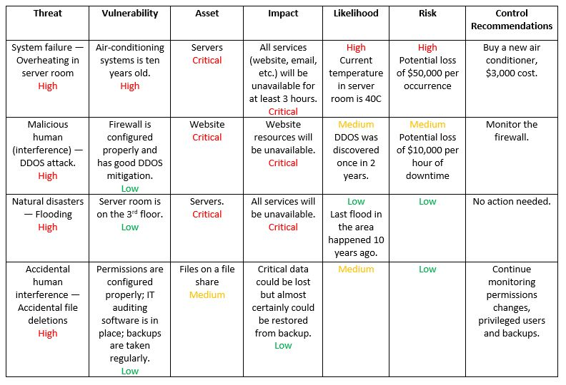
IT risk assessment procedure

Slide 29
IT risk assessment procedure
You can use your risk assessment report to identify key remediation steps that will reduce multiple risks.
  For example, ensuring backups are taken regularly and stored offsite will mitigate the risk of accidental file deletion and also the risk from flooding.
  Each of these steps should have the associated cost and should deliver real benefit in reducing the risks.
  Remember to focus on the business reasons for each improvement implementation.
As you work through this process, you will get a better idea of how the company and its infrastructure operates and how it can operate better.
Then you can create risk assessment policy that defines:
  what the organization must do periodically (annually in many cases)
  how risk is to be addressed and mitigated (for example, a minimum acceptable vulnerability window)
  how the organization must carry out subsequent enterprise risk assessments for its IT infrastructure components and other assets

Slide 30
Pitfalls/Lessons Learned
It is important when structuring an enterprise security risk assessment to include as many stakeholders as possible.
By including a wider selection of operational, finance and human resources management, high-risk potentialities can be identified in areas such as research and development, HIPAA compliance, and sales management.
It is important to include personnel who are not only experienced in the complexities of systems and processes, but also have the ability to probe for areas of risk.
A checklist is a good guideline, but is only the starting point in the process. With an experienced interviewer, the process can be as educational for the interviewee as it is for identifying risks.

Slide 31
Pitfalls/Lessons Learned
Organizational executives have limited time, and it is often difficult to get on their calendars. There are three key steps to ease this part of the process:
  Request that the executive sponsor directly address the interviewees by announcing the purpose of the risk assessment and its importance to the organization.
  Within 48 hours of that communication, have the sponsor’s office schedule the initial interview.
  Send a tailored checklist to the executive prior to the interview and ask him/her to review it. This last step is to prepare him/her for the subject areas of the risk assessment, so that any apprehensions or reservations are allayed as he/ she understands the boundaries of the interview.
It is important not to underestimate the value of an experienced facilitator, particularly for the higher-level interviews and the process of determining the ranking of risk likelihood. The use of experienced external resources should be considered to bring even more objectivity to the assessment.

Slide 32
Case Study

Slide 33
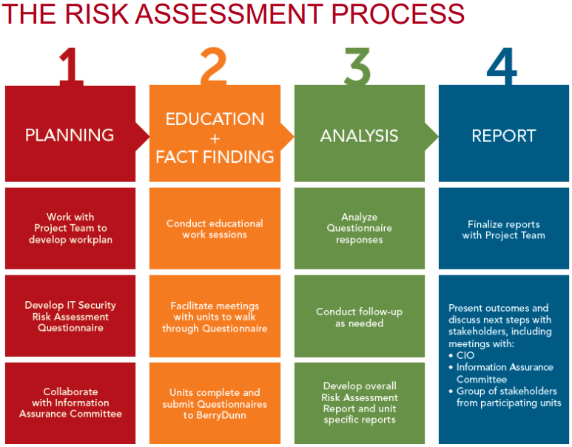

Slide 34


Slide 35
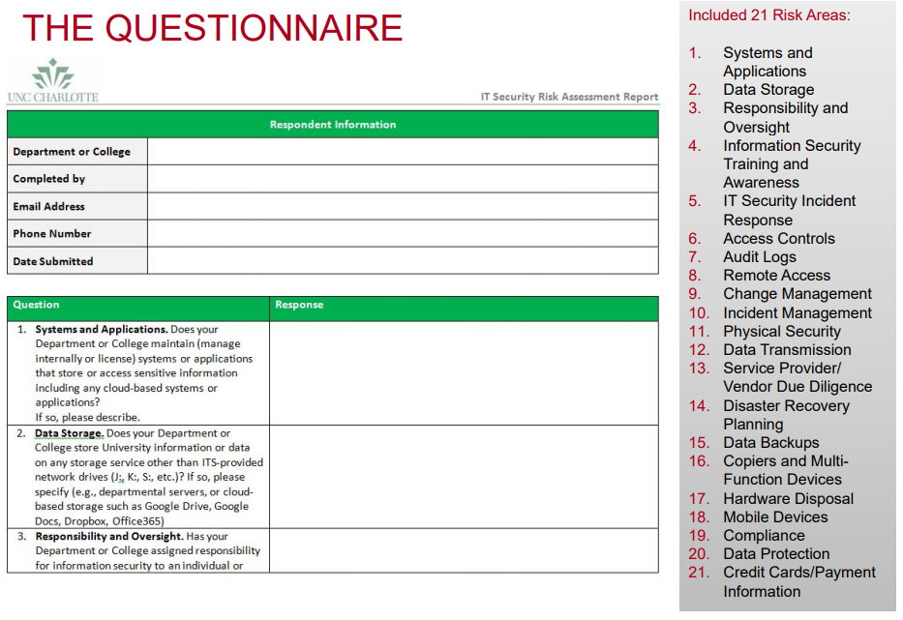

Slide 36


Slide 37
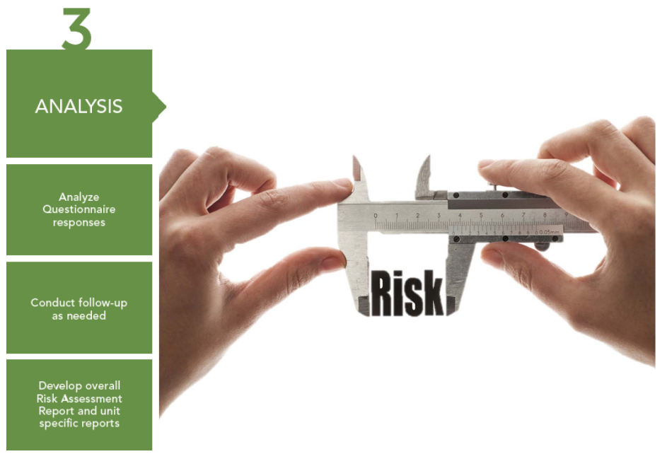

Slide 38
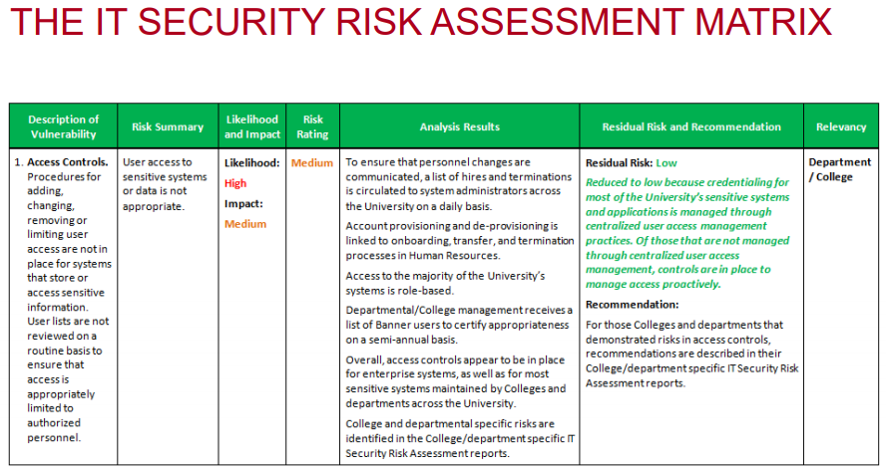

Slide 39
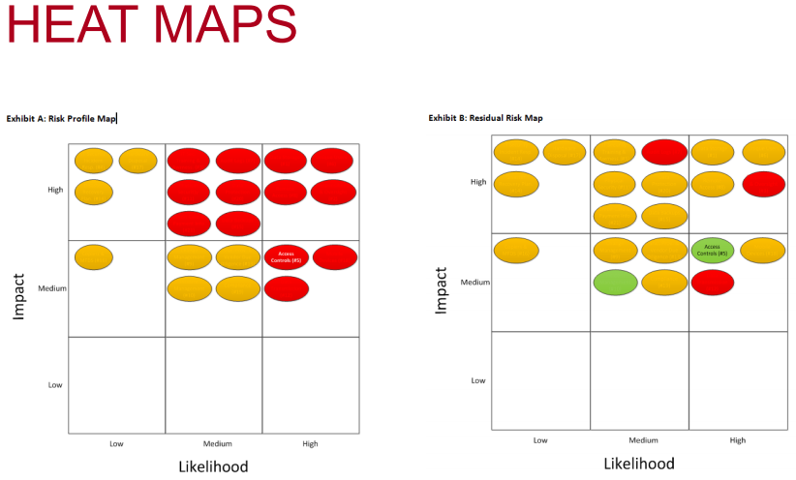

Slide 40
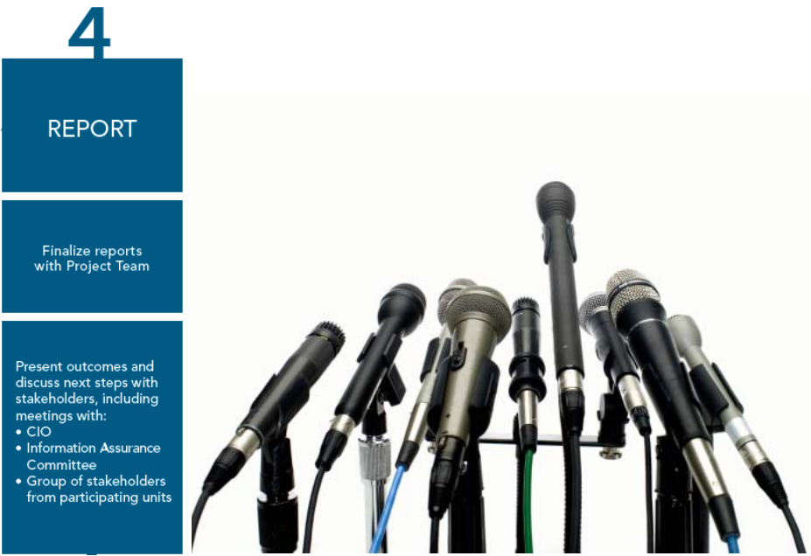

Slide 41
Conclusion
An information security framework is important because it provides a road map for the implementation, evaluation and improvement of information security practices.
A common element in most security best practices is the need for the support of senior management, but few documents clarify how that support is to be given. This may represent the biggest challenge for the organization’s ongoing security initiatives, as it addresses or prioritizes its risks.
Specifically, an enterprise security risk assessment is intended to be suitable for the following, which could be specific to any organization:
  A way to ensure that security risks are managed in a cost-effective manner
  A process framework for the implementation and management of controls to ensure that the specific security objectives of an organization are met
  Use by management to determine the status of information security management activities
  Use by internal and external auditors to determine the degree of compliance with the policies, directives and standards adopted by the organization
  For implementation of business-enabling information security

Slide 42
Conclusion
Overall, an organization must have a solid base for its information security framework.
The risks and vulnerabilities to the organization will change over time; however, if the organization continues to follow its framework, it will be in a good position to address any new risks and/or vulnerabilities that arise.

Slide 43
References
https://www.synopsys.com/software-integrity/resources/knowledge-database/security-risk-assessment.html
https://wikisites.cityu.edu.hk/sites/netcomp/articles/Pages/SecurityRiskAssessment.aspx
https://blog.netwrix.com/2018/01/16/how-to-perform-it-risk-assessment/
https://www.isaca.org/Journal/archives/2010/Volume-1/Pages/Performing-a-Security-Risk-Assessment1.aspx

Slide 44
Thank You.

